Slide 1
An open-source framework for the quantification of Urban Heat Islands based on Swiss open-data
Presenter: Zetong Liu
Supervised by Jerome Kaempf

Slide 2
Work Objectives
1. Build an open-source framework in Python to go from Swiss open-datasets to indicators related to the Urban Heat Island effect
2. Demonstrate the application of scenarios on one case-study representative of the Swiss landscape, quantifying improvement measures

Slide 3
Previous Work
Olivier Chavanne's master thesis
A python workflow was built:
1, Process and analyze information of all buildings in the area of his study
2, Simulate the surface temperature of those buildings through Citysim.
To measuring the effect of UHI, the effect of different kinds of grounds, e.g. asphalt road, concrete road, green areas, around buildings need to be added.

Slide 4
Identification of necessary open-data
swissBUILDINGS3D 3.0 Beta -> Buildings as 3D models
geodienste.ch, official survey -> geometric footprints of buildings
swissALTI3D -> coordinates of grounds
swissTLM3D -> roads and green ground
IDAWEB and Meteonorm-> climate data

Slide 5
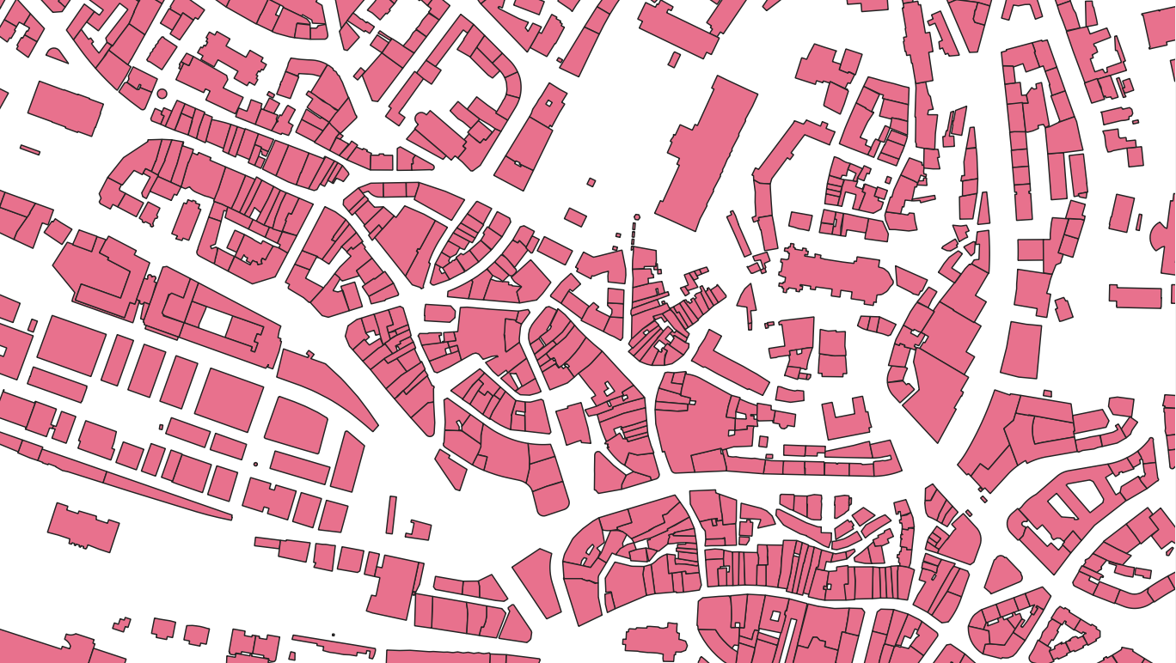
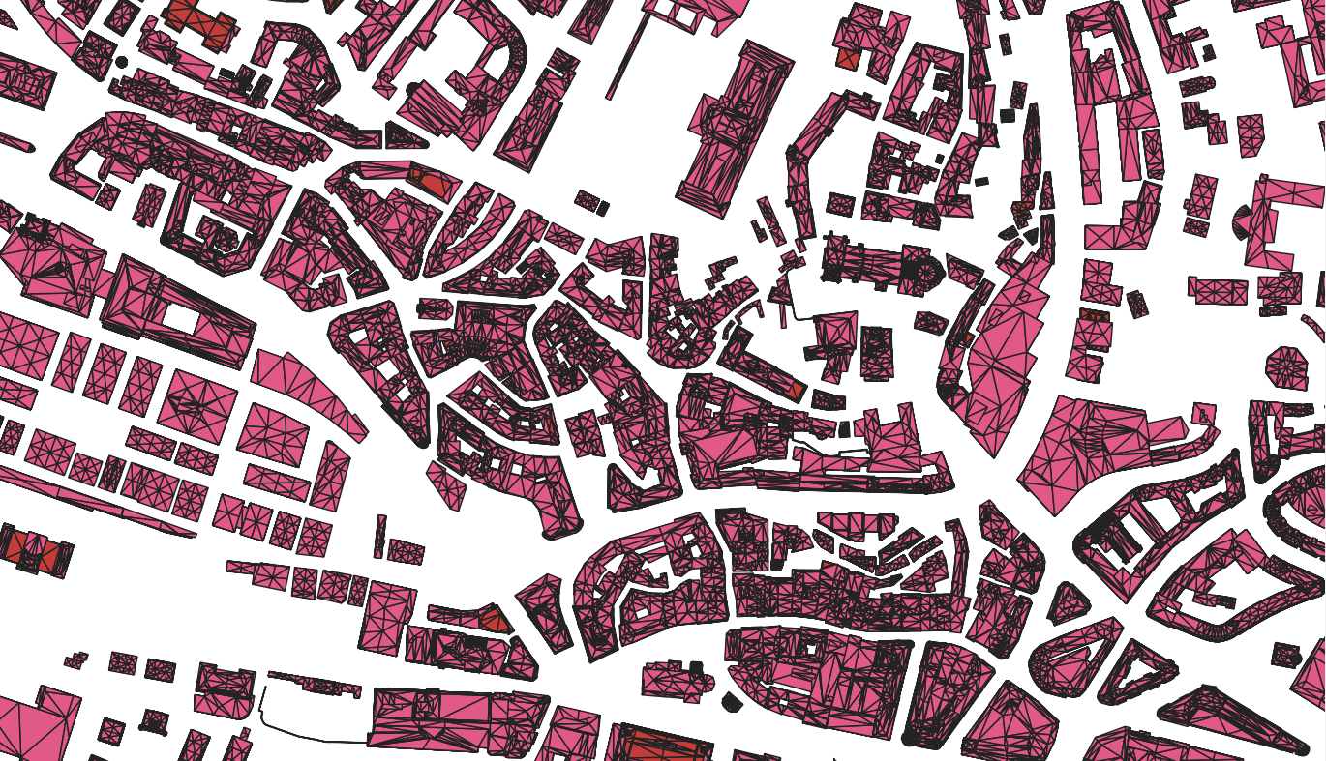
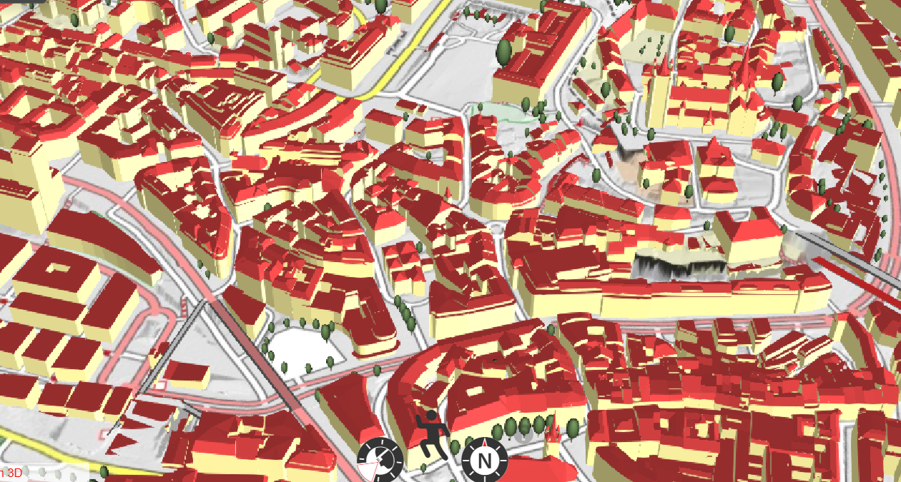
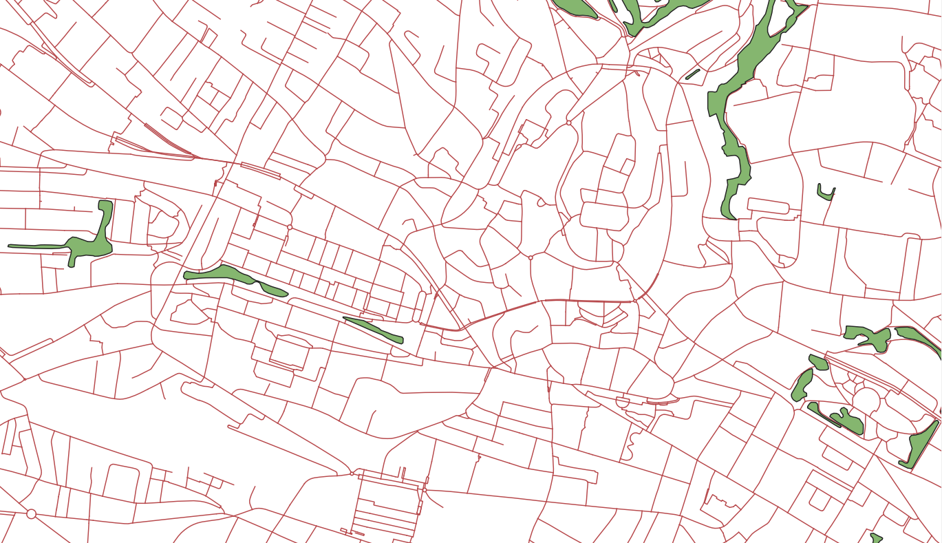
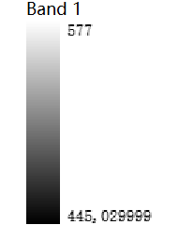

Visualisation of Swiss open datasets in QGIS
Official Survey, layer lcsf filtered by genre=‘batiment’
SwissBuildings3D, layers roof, wall and floor
SwissTLM 3D, layers tlm_bb_bodenbedeckung and
tlm_strassen_strasse
SwissALT 3D

Slide 6
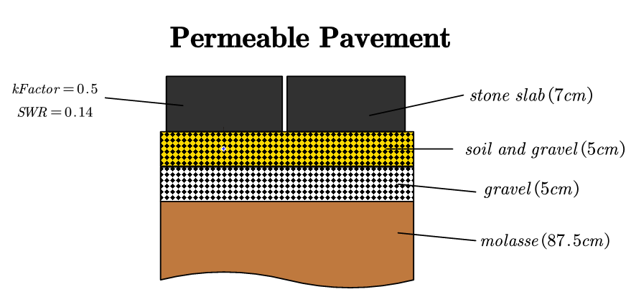
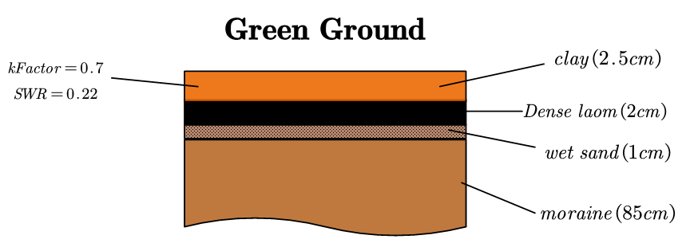
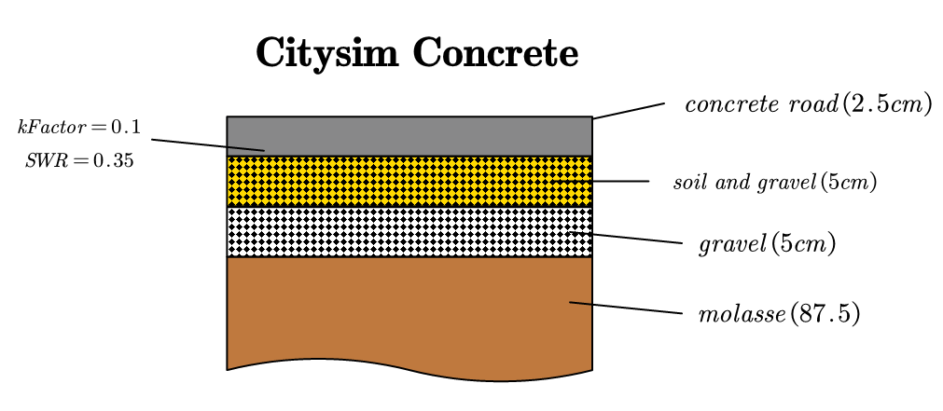
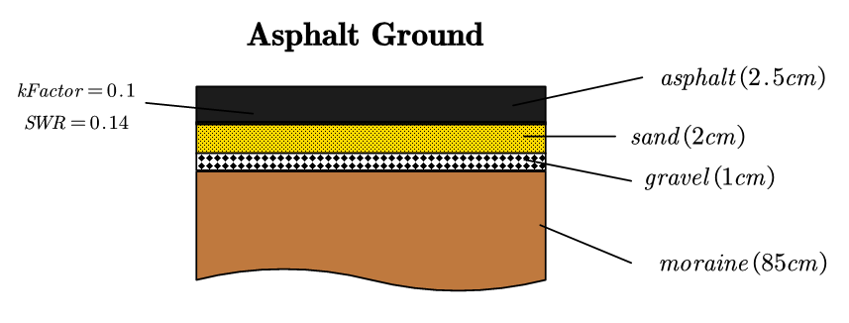
Defined composites of grounds
kFactor represents humidity of the material
the ability to reflect solar energy

Slide 7


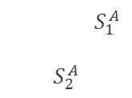
Code work
def add_ground_from_XYZ(MO_dhn, district, terrain_df, zone_box, center_coordinates=(0,0), kFactor, groundtype, detailedSimulation=False, ShortWaveReflectance)
Create mesh of ground
Discard grounds under buildings:
Create a box around zone_tout
Only keep triangle surfaces that are in the box and not intersects with any buildings in zone_cad
Create a geodataframe that contains all triangles objects and assign all grounds the type of concrete road
v1
v2
FINAL PRESENTATION
$S_{1}^{A}$
$$S_{2}^{A}$$
v4
v3

Slide 8
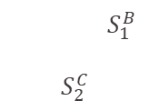
Code work
def modify_type(district, ground_data, green_data, street_data, green_groundtype, road_groundtype, green_kfactor, green_SWR, road_kfactor, road_SWR) #
Find grounds of road and green area through intersection with streets and green area objects
Modify the type of original ground to a new type of road ground(concrete, asphalt or permeable pavement) or green area and attach physical characteristics like kFactor and short wave reflectance accordingly
Buffer street from line objects to polygon objects
Find the list of triangles that intersect with buffered streets, then modify corresponding triangles
Do the same for green areas
FINAL PRESENTATION
$S_{1}^{A}$
$$S_{2}^{A}$$
$S_{1}^{B}$
$$S_{2}^{C}$$

Slide 9
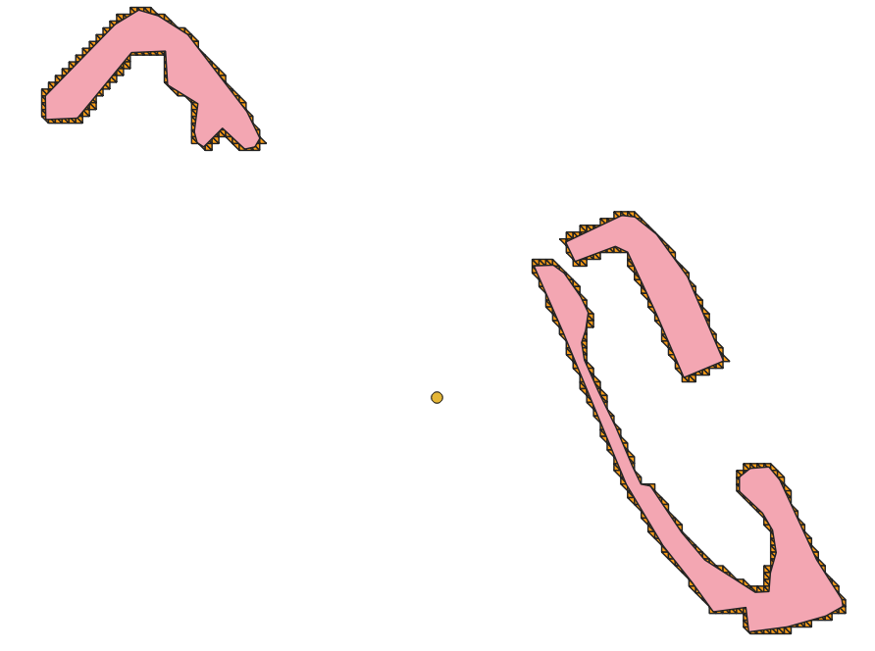
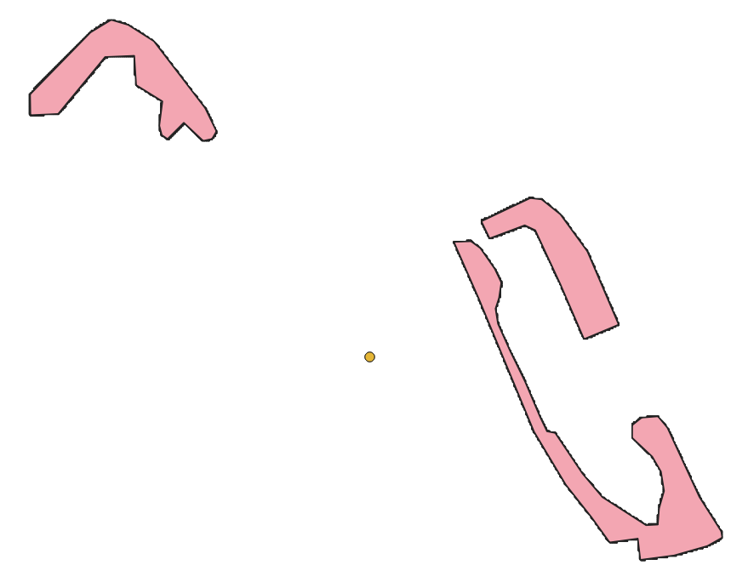
Example of simulation with different resolution of ground mesh
Green area simulated by coarse ground mesh
Green area simulated by fine ground mesh

Slide 10
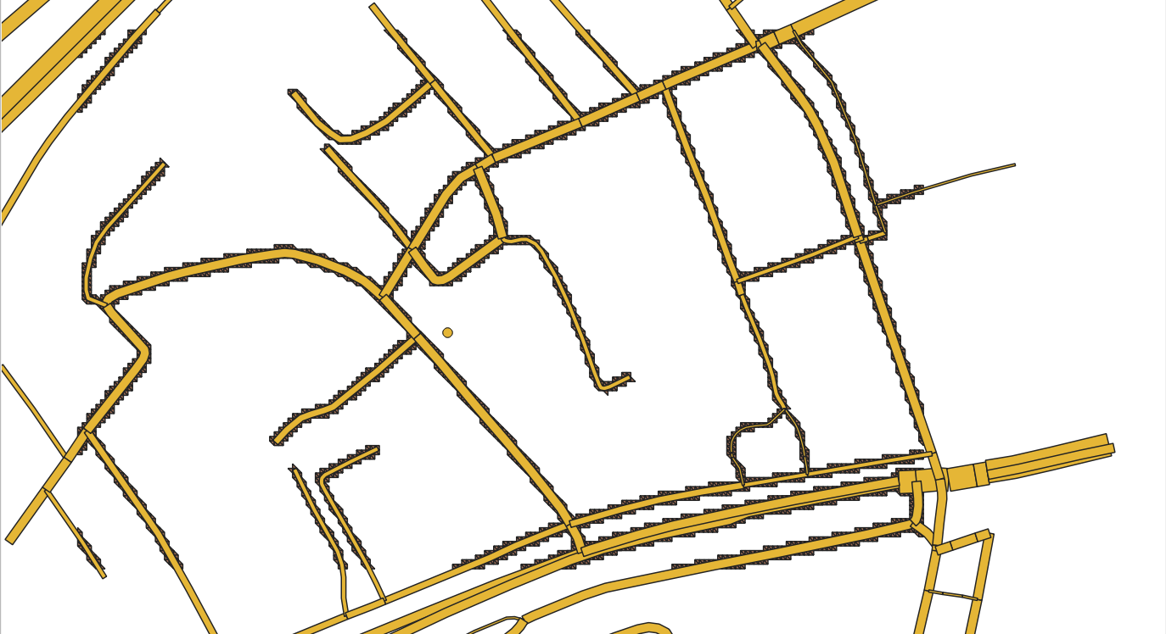
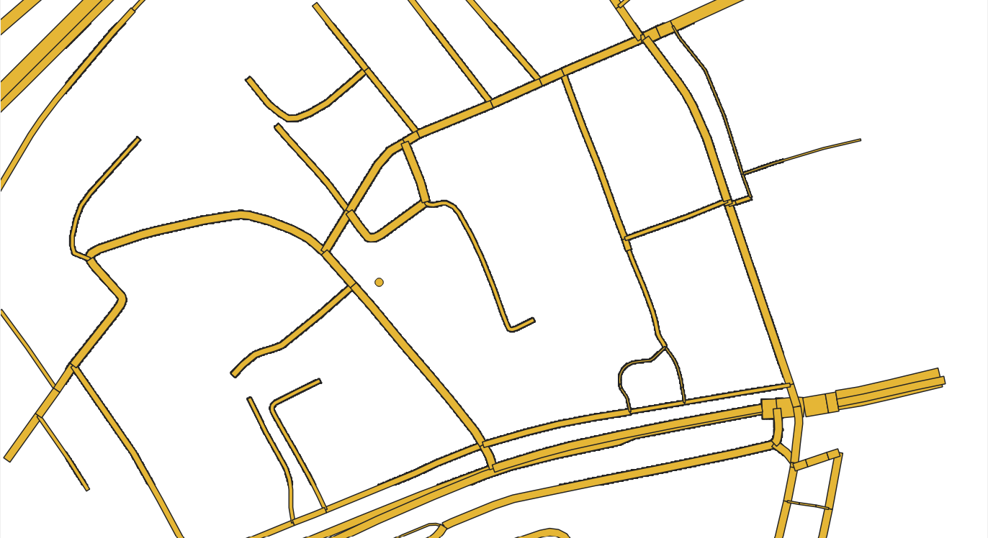
Example of simulation with different resolution of ground mesh
Roads simulated by ground mesh (resolution=2m)
Roads simulated by fine ground mesh(resolution=0.5m)

Slide 11
Code work
def cut(district, ground_data, MO_dhn, footprints, kept_range=15)
Create a buffer of 15 meters around each buildings within my study area of interest
Only keep grounds within the convex hull of those buffered buildings
Only keep buildings that intersect or are within convex hull of those buffered buildings
Reasons:
1, Distant buildings and roads have little thermal impact on my study area of interest.
2, Save computational time.
FINAL PRESENTATION

Slide 12
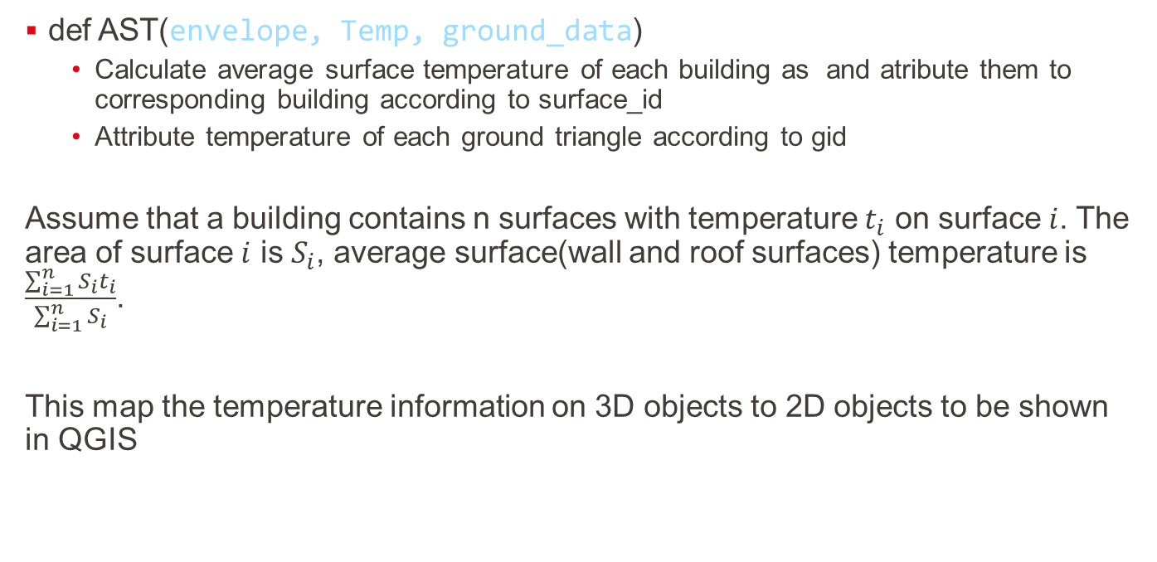
Code work
def AST(envelope, Temp, ground_data)
Calculate average surface temperature of each building as and atribute them to corresponding building according to surface_id
Attribute temperature of each ground triangle according to gid
Assume that a building contains n surfaces with temperature $t_{i}$ on surface $i$. The area of surface $i$ is $S_{i}$, average surface(wall and roof surfaces) temperature is $\frac{\sum_{i=1}^{n}{S_{i}t_{i}}}{\sum_{i=1}^{n}{S_{i}}}$.
This map the temperature information on 3D objects to 2D objects to be shown in QGIS
FINAL PRESENTATION

Slide 13
Workflow
Streets
Green areas
Streets
Scenario1
Climate
Xml_root
modify_type
Xml(ground modified)
Zone_cad
cut
Zone_tout
Xml(distant objects cut)
add_ground_from_XYZ
Xml(default ground)
Wall
Floor
roof
FINAL PRESENTATION
Simulate-Citysim
Envelope
Temperature(_TS.out)
XYZ
AST
Surface_with_temperature

Slide 14
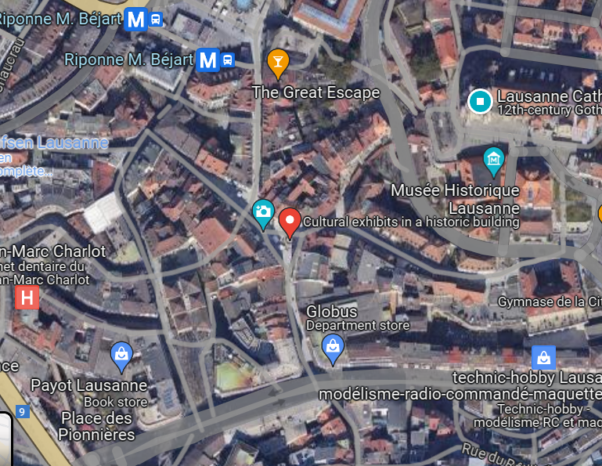
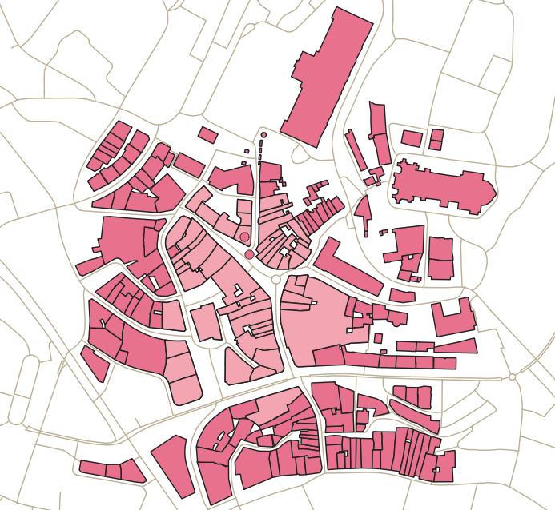
Case Study – Fontaine de la Justice, Lausanne
Motivation: It’s important to keep small roads cool in old town center

Slide 15
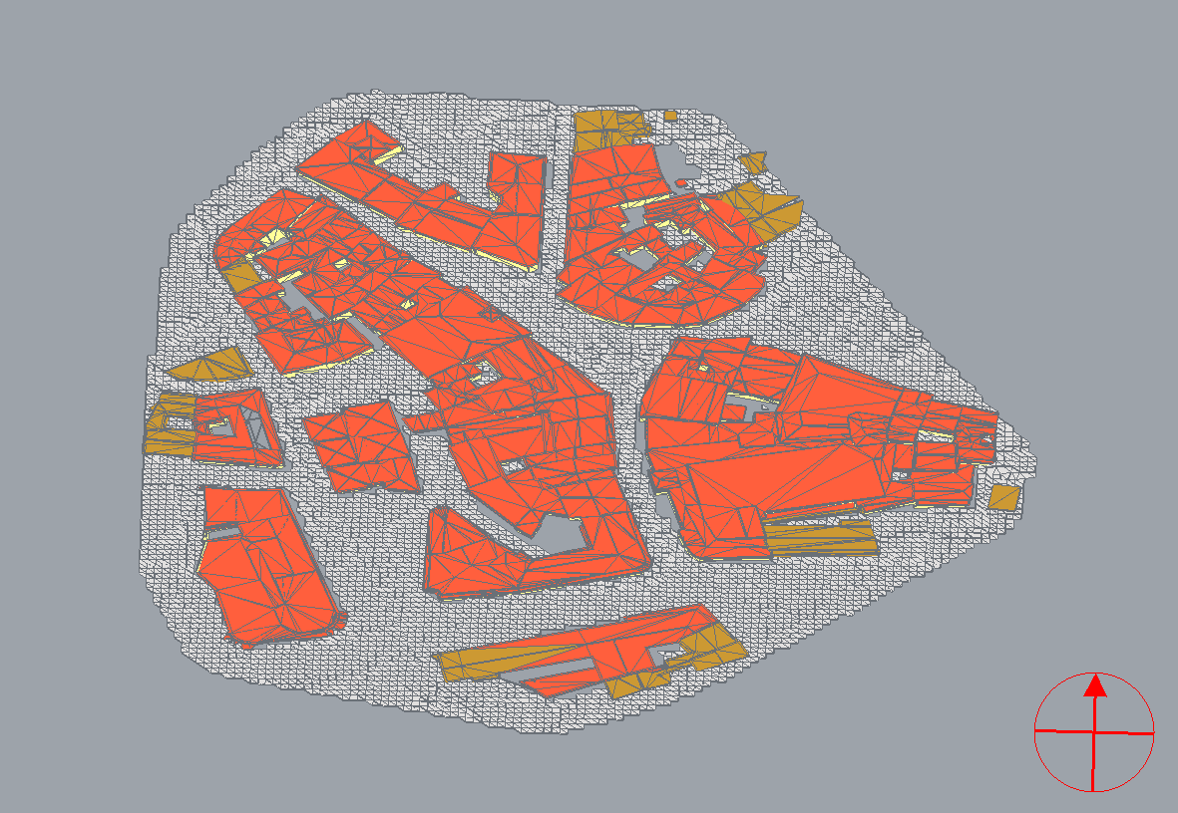
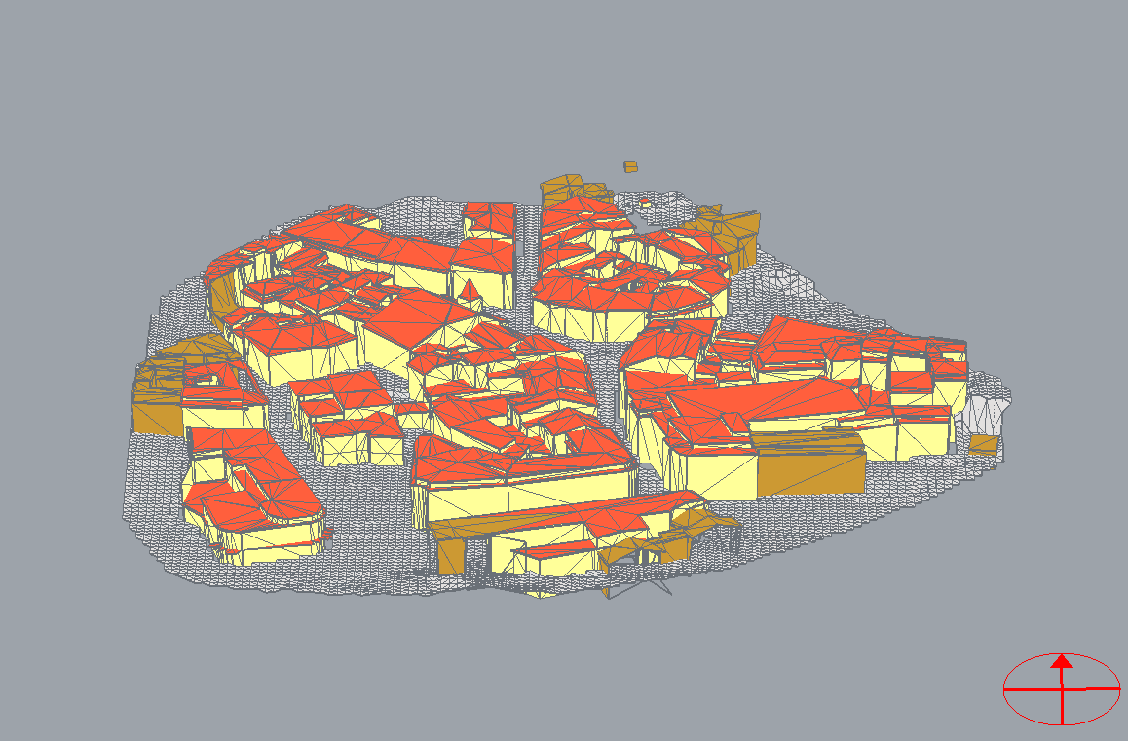
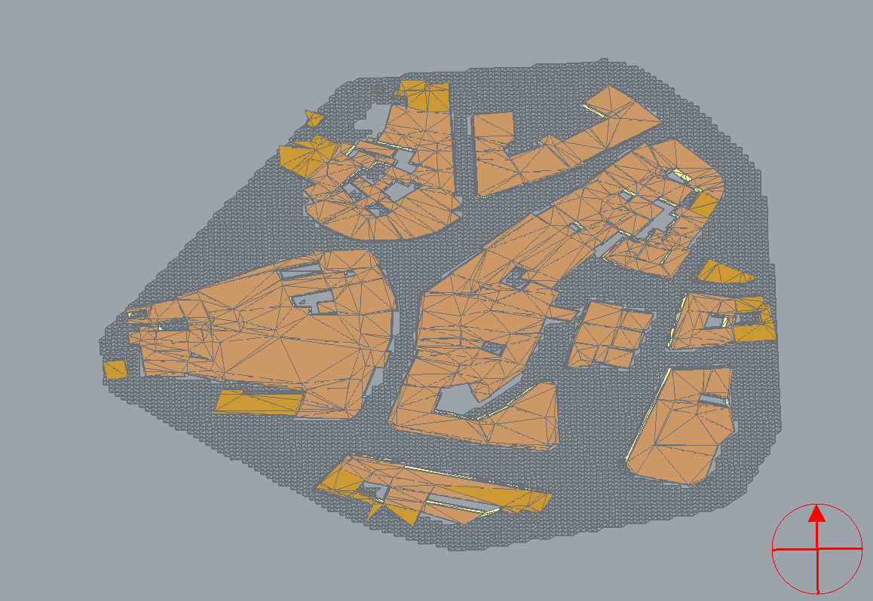
CitySim Pro Visualization
3D view
Bottom view
Top view

Slide 16
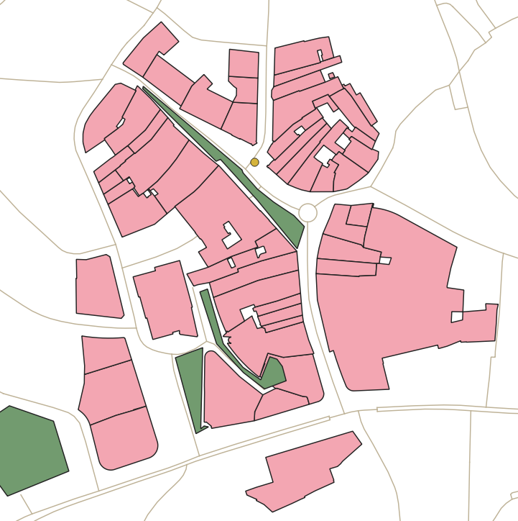
Scenario 1: replace some city roads with green area

Slide 17
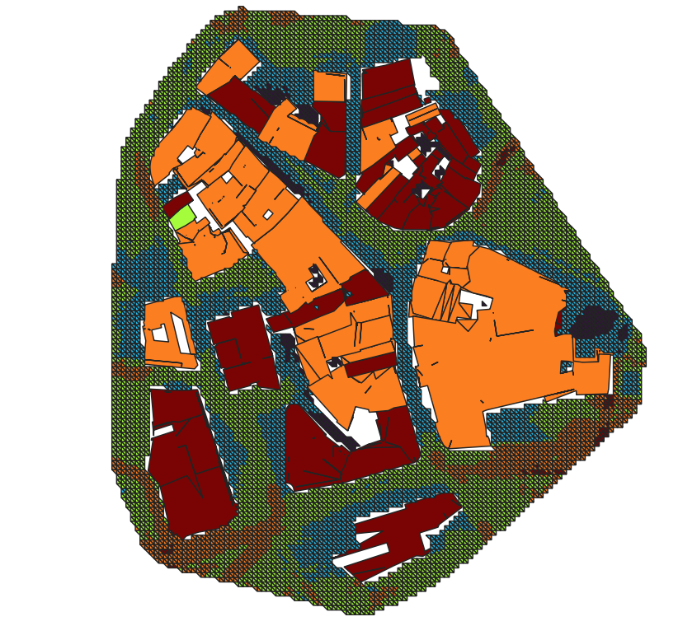
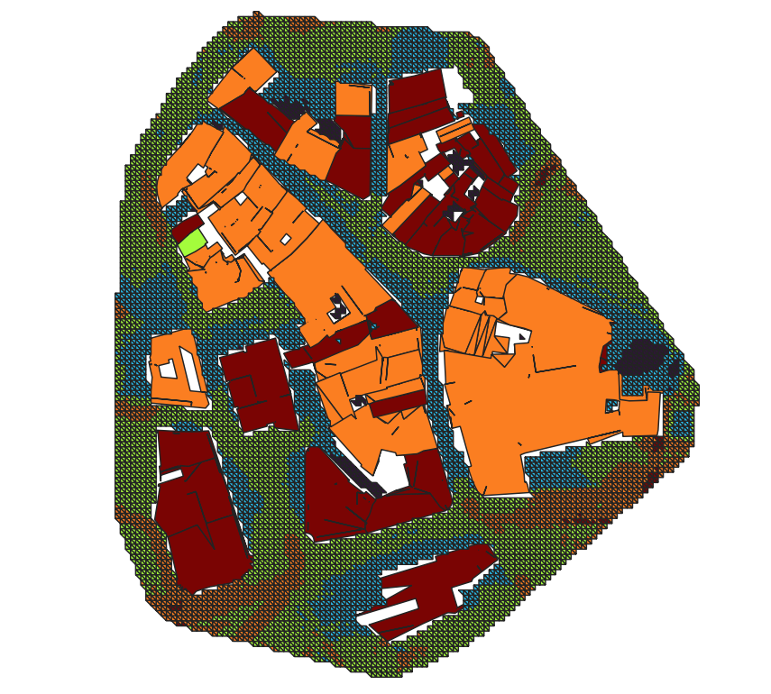
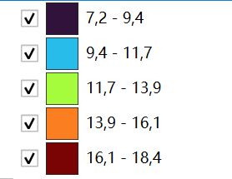
Temperature classification(Celsius degree)
Before adding green area
After adding green area

Slide 18
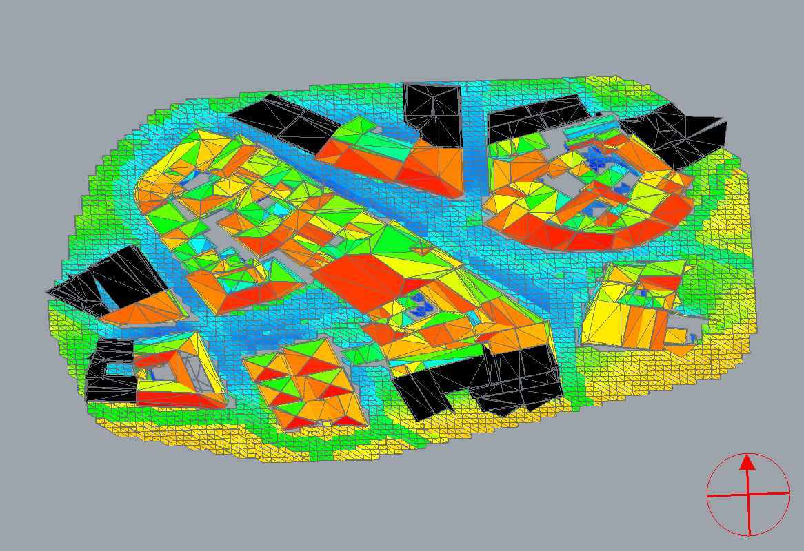
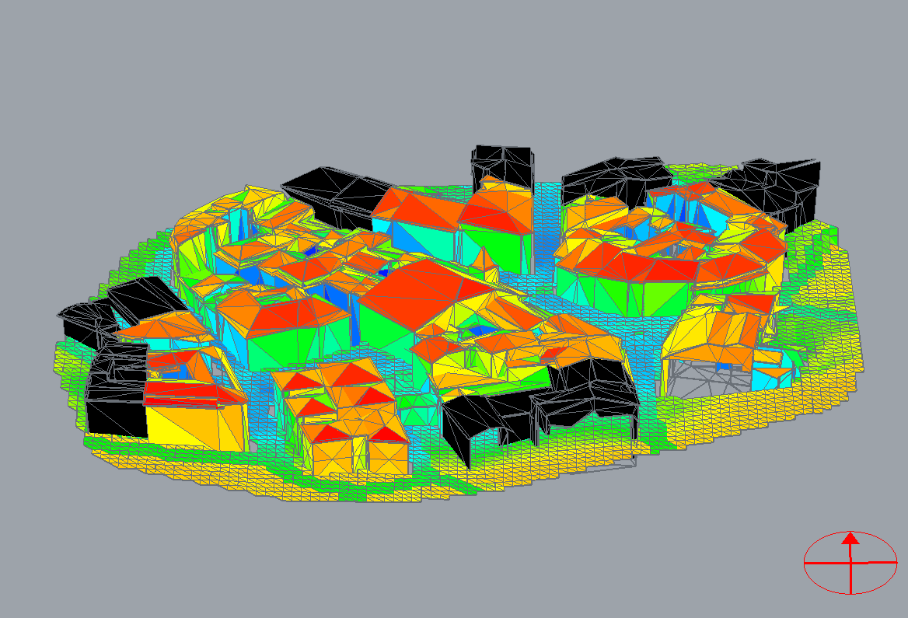
Scenario 1: replace some city roads with green area
A samller sample of current case: Contemporary yearly average surface temperature
Colorful buidings = buildings of interest
Dark buildings = buidlgins just to cast shades
Streets is colder due to shadows and green areas

Slide 19
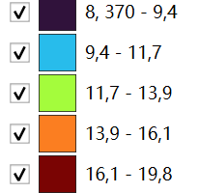
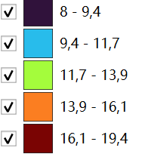
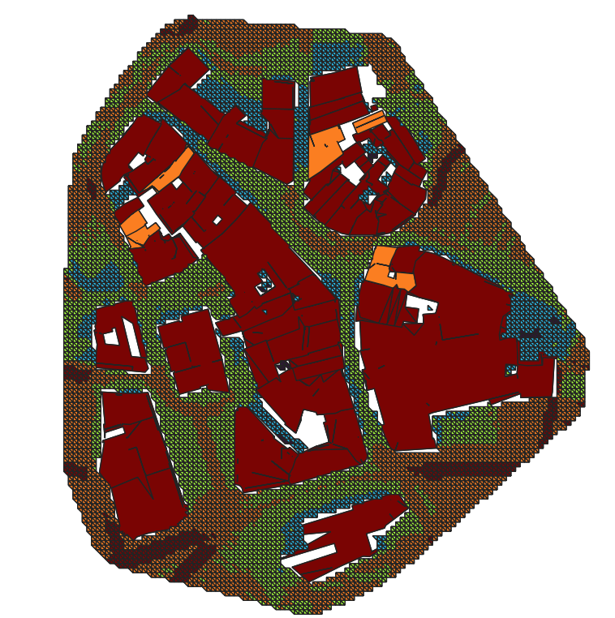
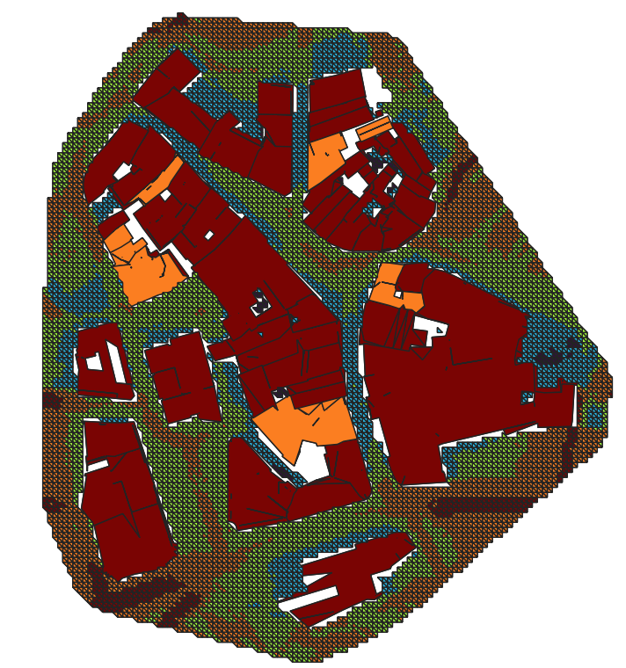
Climate change
2040
Contemporary
2030
Evident temprerature increment

Slide 20
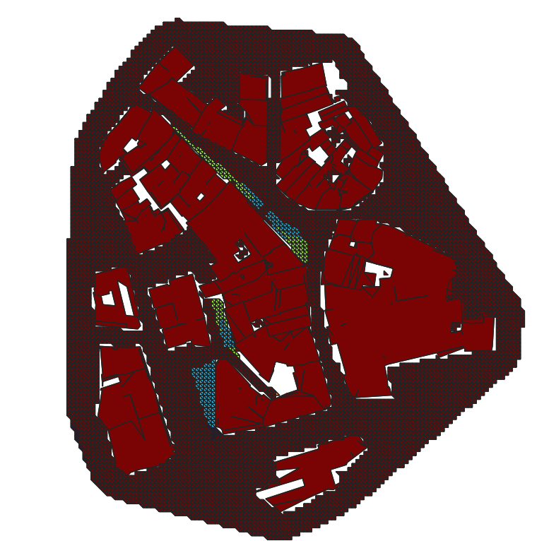
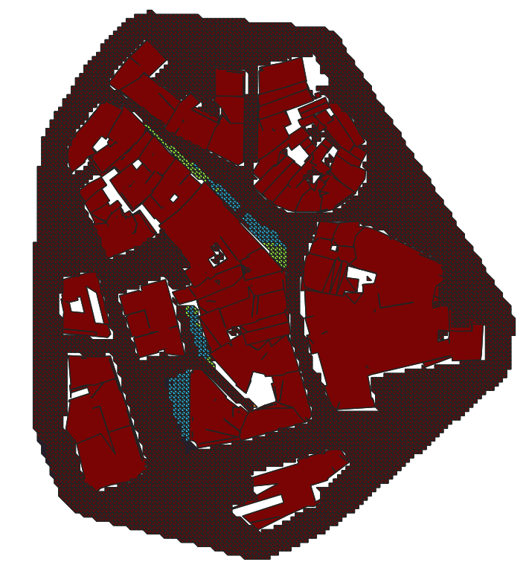
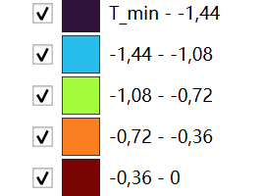
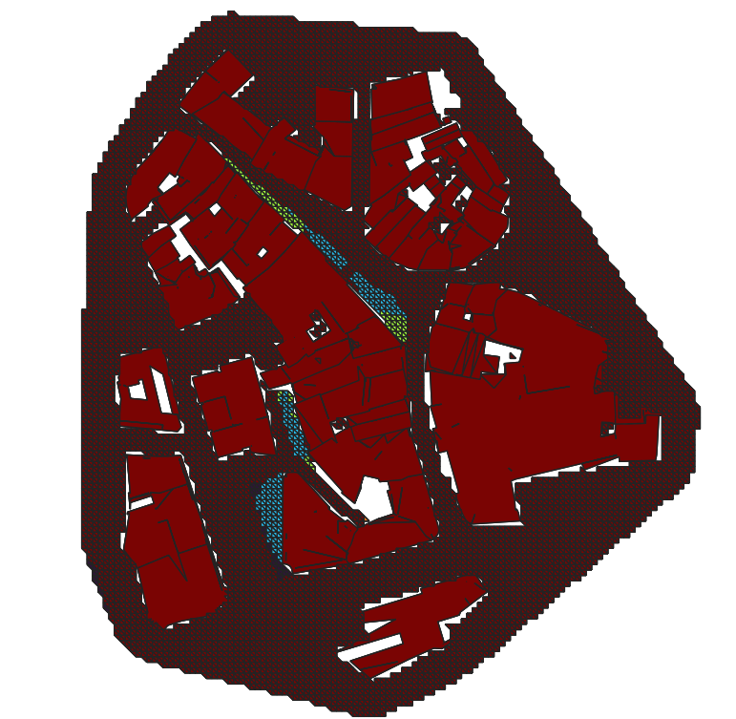
Decreased Temperature w.r.t climate change
Contemporary
2030
2040
range
[-1.81, 0]
[-1.9, 0]
[-1.93, 0]
Weighted average
-0.02297
-0.02400
-0.02431
Effects of cooling brought by green areas prevail

Slide 21
Conclusions
Obtained open-data for grounds and visualised them in QGIS
Finalised the mesh of grounds
Obtained open-data for green area and roads, and attributed right physical characteristics
Run the case of Lausanne and visualised the results in CitySim Pro
Gather Meteorological data for now, 2030, 2040, 2050
Run case-study with meteorological data and visualise reseults in QGIS
Demonstrate one scenario with original grounds replaced by green grounds and visualized their effects on urban heat islands in QGIS
Identified that decreased temperature around green area is perceptible.
Github: https://github.com/ZetongLiu/UHI_CH_sp

Slide 22
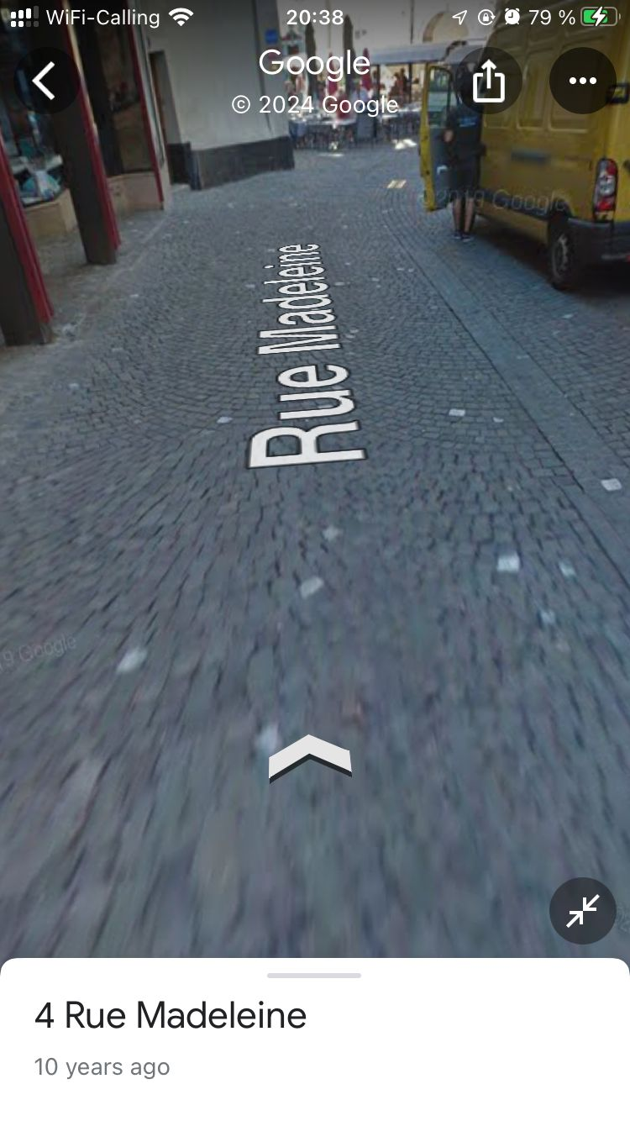
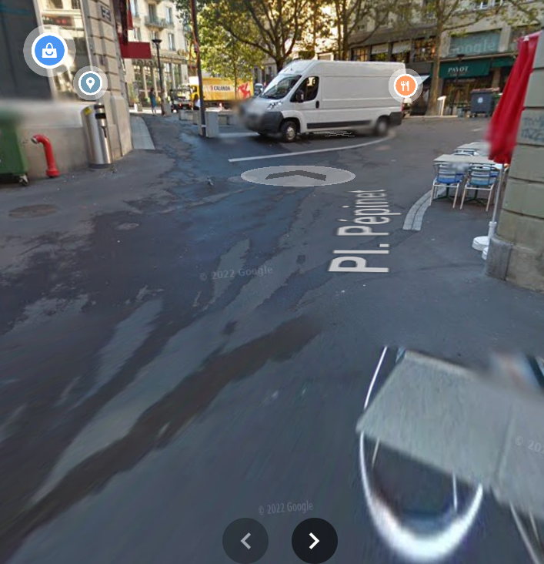
Prospects
Develop an algorithm that can create adaptive mesh of grounds, i.e. finer mesh at sharp part of geometry objects.Run case-study with trees and showcase their effects on UHI
Attach the exact types of street in reality to each street data and change ground type accordingly.
Add trees into our framework and study their effects on UHI
Add water into our framework and study their effects on UHI

Slide 23
References
https://github.com/ochavanne/CAD-O
Upadhyay, G ; Kämpf, J; Scartezzini, J: Ground temperature modeling: The case study of Rue des Maraîchers in Geneva, 2014, URL: https://infoscience.epfl.ch/record/198754?ln=fr
https://github.com/kaemco/CitySim-Solver/wiki/The-district#groundsurface
https://www.eoas.ubc.ca/courses/eosc350/content/foundations/properties/density.htm#:~:text=Remarks,2.6%20and%202.7g%2Fcc.
https://www.bruk.info.pl/en/guide/stone-size-thickness-and-chamfer-should-technical-parameters-matter-to-us/
https://www.sciencedirect.com/science/article/pii/S2214509518300482#sec0010
FINAL PRESENTATION

